Slide 1


MCSC0009:
Image Processing And Analysis
Image Sensing, Acquisition and Formation
Class Presentations on Image Processing And Analysis by Prof. Anand Singh Jalal

Slide 2
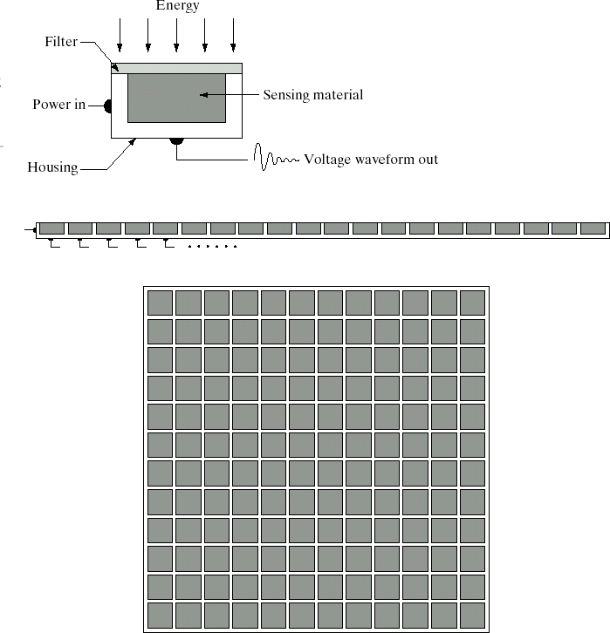
Sensors
Sensors are use to transform illumination energy into digital images.
Sensors are three types:
Single Imaging Sensor
Line sensor
Array Sensor
Single Imaging Sensor
Line sensor
Array Sensor

Slide 3
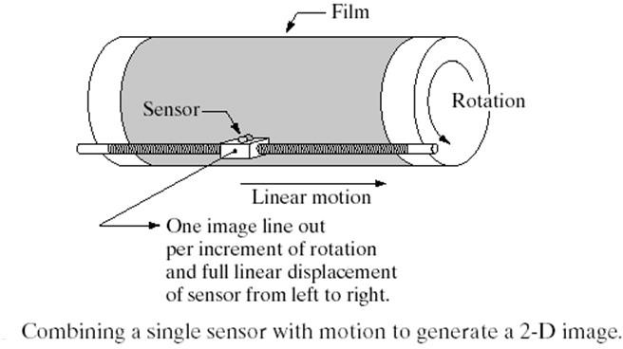
Sensors: Single Sensors
Image acquisition using a single sensor
To generate a 2-D image using a single sensor, there has to be relative displacements in both the x- and y-directions between the sensor and the area to be imaged.

Slide 4
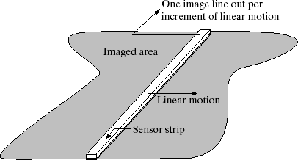
Sensors: Linear Sensor
A geometry that is used much more frequently than single sensors consists of an in-line arrangement of sensors in the form of a sensor strip.
The strip provides imaging
elements in one direction. Motion perpendicular to the strip provides imaging in the other direction

Slide 5
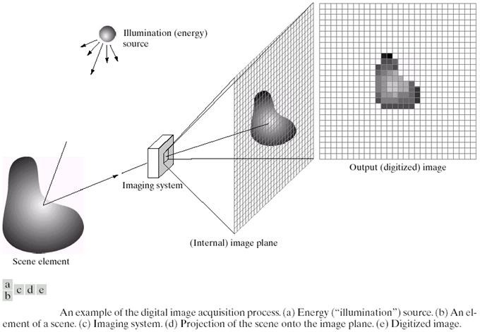
Sensors: Array Sensor

Slide 6
A simple image formation model
Image: a 2-D light-intensity function f(x,y)
f(x,y): the intensity is called the gray level for monochrome image
0 < f(x,y) < ∞
Nature of f(x,y):
The amount of source light incident on the scene being viewed
The amount of light reflected by the objects in the scene

Slide 7
A simple image formation model …
f(x, y) is characterized by two components
Reflection / Absorption of energy from source by object
Illumination
Source
Image of the object
i(x, y) illumination component |  | r(x, y) reflectance component

Slide 8

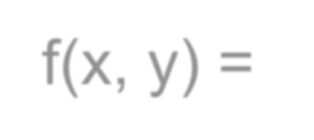

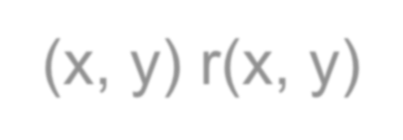


A simple image formation model…
f(x, y) = i(x, y) r(x, y)
where
0 < i(x, y) < ∞
and
0 < r(x, y) < 1
Total
Absorption
Total
Reflection
Typical values of i(x, y)
On a sunny day, illumination on earth’s surface is 90,000 lm/m²
On a cloudy day it is 10,000 lm/m²
Full moon yields 0.01 lm/m²
Commercial office yields 1000 lm/m²
Typical values of r(x, y)
for black velvet – 0.01
Stainless steel – 0.65
Flat white wall paint – 0.90
Snow – 0.93

Slide 9
Image Digitization
Why do we need digitization?
What is digitization?
How to digitize an image?

Slide 10
Why Digitization?
Theory of Real numbers - between any two given points there are infinite number of points
An image can be represented by infinite number of points
Each such image point may contain one of the infinitely many possible intensity/color values needing infinite number of bits
Obviously such a representation is not possible in any digital computer

Slide 11
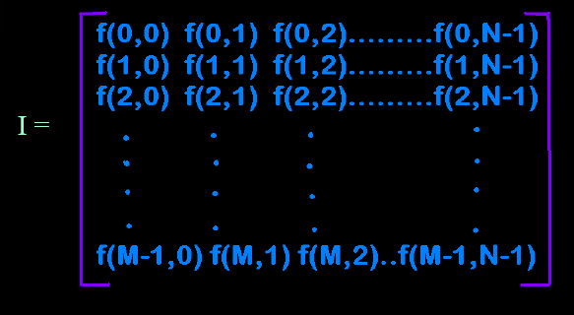
What is desired?
An image to be represented in the form of a finite 2-D matrix
Each of the matrix elements should assume one of finite discrete values

Slide 12
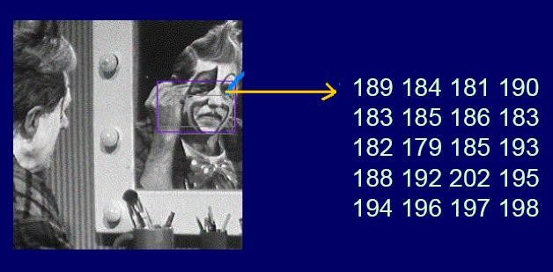
Image as a Matrix of Numbers

Slide 13
What is Digitization?
Image representation by 2-D finite matrix. It is related to coordinates values
Sampling
Each Matrix element represented by one of the finite set of discrete values. It is related to intensity values
Quantization

Slide 14
Image Sampling and Quantization
To convert an Image to digital form, we have to sample the Image in both coordinates (spatial domain) and in amplitude.
Digitizing the coordinate (spatial domain) values is called sampling. (Nyquist frequency)
Digitizing the amplitude values is called
quantization.

Slide 15
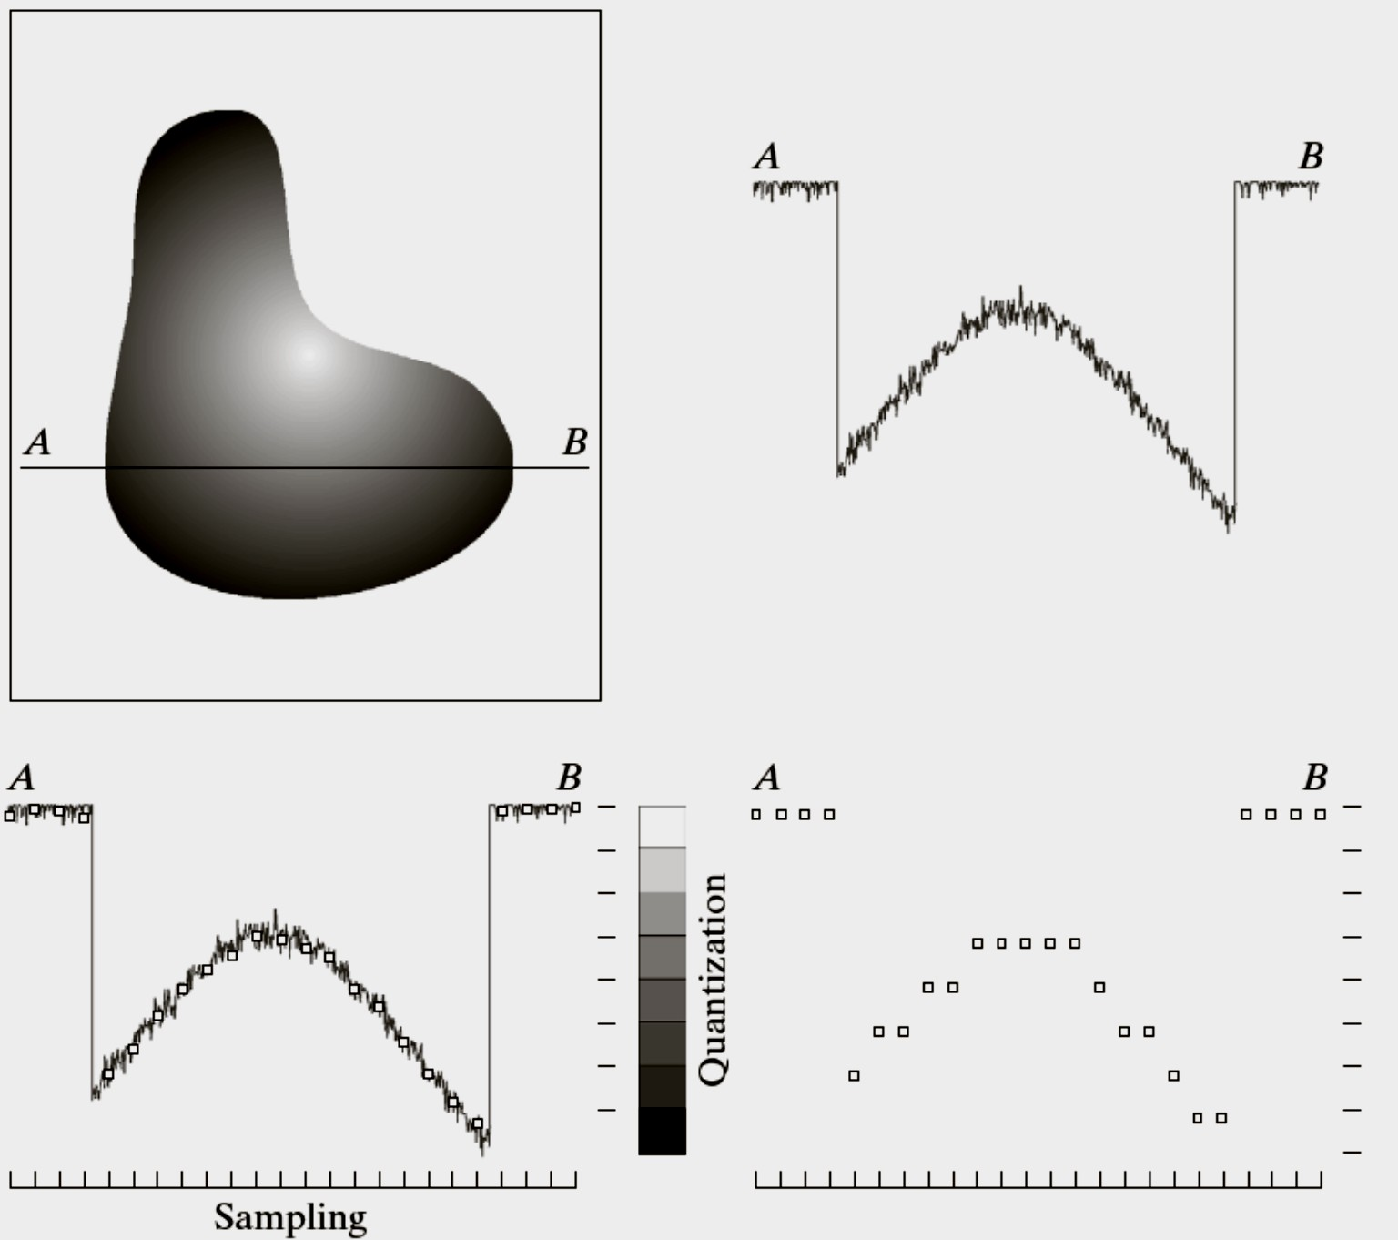
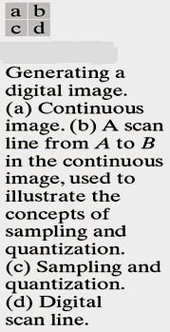
Sampling and Quantization

Slide 16
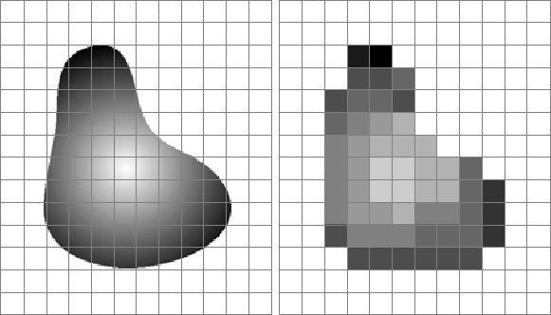
Sampling and Quantization
Image before sampling and quantization
Result of sampling and quantization

Slide 17
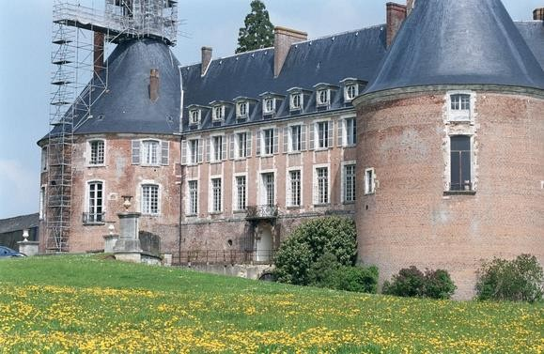
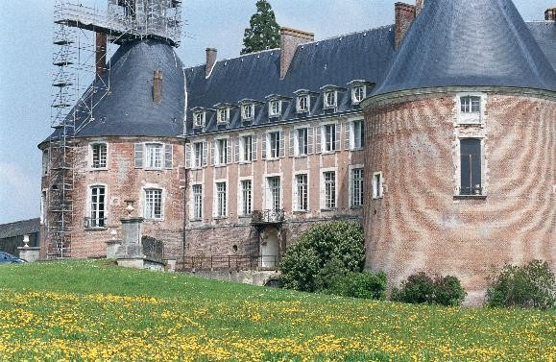
Aliasing
Spatial
insufficient
Aliasing: is sampling of
data along the space axis, which occurs because of the insufficient spatial resolution of the acquired image.
Critical Sampling Distance:
is the Sampling corresponding Nyquist Rate.
Distance to the
Aliasing problem of a
undersampled image

Slide 18
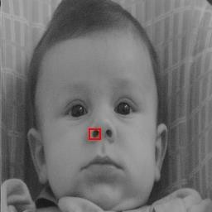
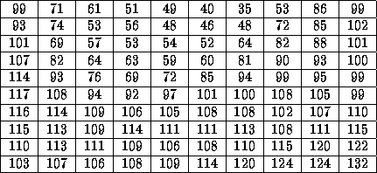
Digital Image?
When x, y and the amplitude values of f are finite, discrete quantities, the image is called digital image
A digital image is composed of a finite number of elements, each of which has a particular location and value. These elements are referred to as picture elements, image elements, pels and pixels.

Slide 19

Digital Image?
0 | 0 | 0 | 75 | 75 | 75 | 128 | 128 | 128 | 128
0 | 75 | 75 | 75 | 128 | 128 | 128 | 255 | 255 | 255
75 | 75 | 75 | 200 | 200 | 200 | 255 | 255 | 255 | 200
128 | 128 | 128 | 200 | 200 | 255 | 255 | 200 | 200 | 200
128 | 128 | 128 | 255 | 255 | 200 | 200 | 200 | 75 | 75
175 | 175 | 175 | 225 | 225 | 225 | 75 | 75 | 75 | 100
175 | 175 | 100 | 100 | 100 | 225 | 225 | 75 | 75 | 100
75 | 75 | 75 | 35 | 35 | 35 | 0 | 0 | 0 | 35
35 | 35 | 35 | 0 | 0 | 0 | 35 | 35 | 35 | 75
75 | 75 | 75 | 100 | 100 | 100 | 200 | 200 | 200 | 200

Slide 20
Image Size
Requires decisions about values for M, N, and for the number, L, the number of gray levels typically is an integer power of 2:
L = 2^{K}
Where k is number of bits require to represent a grey value
The discrete levels should be equally spaced and that they are integers in the interval [0, L-1].

Slide 21
Image Size
The number, b, of bits required to store a digitized image is
b=M*N*k.
For an image of 512 by 512 pixels, with 8 bits per pixel:
🞑 Memory required = 256K bytes= 0.25 megabytes

Slide 22
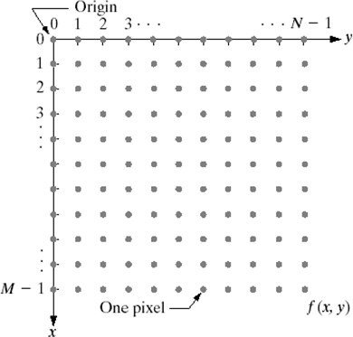
Coordinate Convention used

Slide 23
Image Resolution
How many samples and gray levels are required for a good approximation?
🞑 Resolution (the degree of discernible detail) of an image depends on sample number and gray level number.
🞑 i.e. the more these parameters are increased, the closer the digitized array approximates the original image.
🞑 But: storage & processing requirements increase rapidly as a function of N, M, and k

Slide 24
Image Resolution
Spatial Resolution: Spatial resolution is the smallest detectable detail in an image.
Dots/pixels per unit distance
dots per inch – dpi
Gray level (Intensity) Resolution: Gray-level resolution similarly refers to the smallest detectable change in gray level.
The more samples in a fixed range, the higher the resolution
The more bits, the higher the resolution

Slide 25
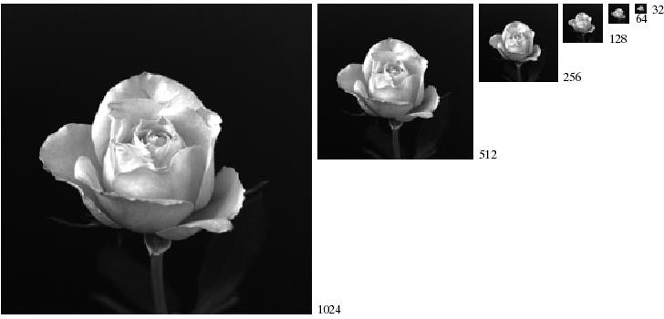
Spatial Resolution
A 1024*1024, 8-bit image subsampled down to size 32*32 pixels. The number of allowable gray levels was kept at 256

Slide 26
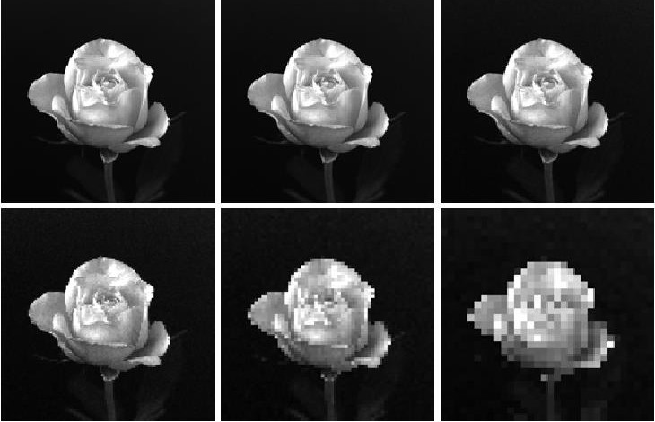
(a) 1024*1024, 8-bit image. (b) 512*512 image resampled into 1024*1024 pixels by row and column duplication. (c) through (f) 256*256, 128*128, 64*64, and 32*32 images resampled into 1024*1024 pixels.

Slide 27
Checkerboard Effect
When the no. of pixels in an image is reduced keeping the no. of gray levels in the image constant, fine checkerboard patterns are found at the edges of the image. This effect is called the checker board effect.

Slide 28
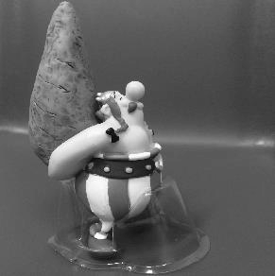


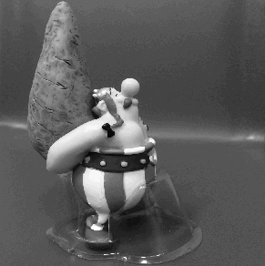
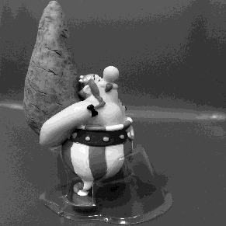
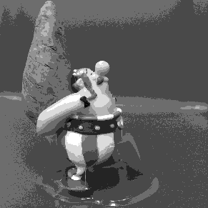
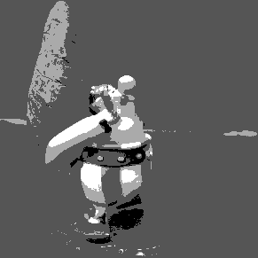
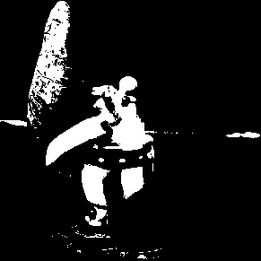
Gray level (Intensity) Resolution
Quantization
8-bit
7-bit
6-bit
5-bit
4-bit
3-bit
2-bit
1-bit

Slide 29
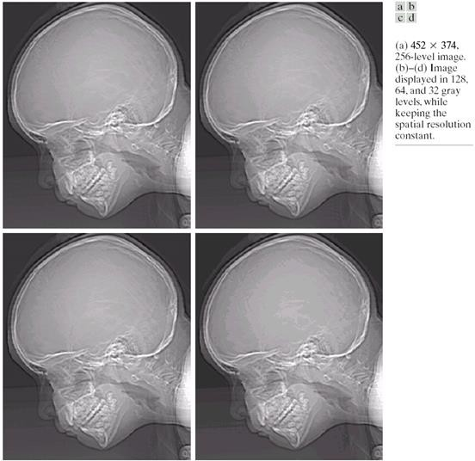
Gray level (Intensity) Resolution …
Varying the number of gray levels

Slide 30
False Contouring
When the no. of gray-levels in the image is low, the foreground details of the image merge with the background details of the image, causing ridge like structures. This degradation phenomenon is known as false contouring.

Slide 31
Gray level (Intensity) Resolution …
False contouring
Varying the number of gray levels

Slide 32
Resolution: How Much Is Enough?
The big question with resolution is always how much is enough?
🞑 This all depends on what is in the image and what you would like to do with it
🞑 Key questions include
Does the image look pleasing?
Can you see what you need to see within the image?

Slide 33

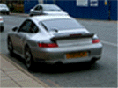
Resolution: How Much Is Enough? ...
The picture on the right is fine for counting the number of cars, but not for reading the number plate

Slide 34
Question
Q1: If we want to resize a 1024x768 image to one that is 600 pixels wide with the same aspect ratio as the original image, what should be the height of the resized image?
Sol:
Aspect Ratio = ^{width}
height

Slide 35
Question …
For the original image the Aspect ratio is: 1027/768=1.33
Now for the resized image, we want the same aspect ratio but a width of 600 pixels.
width
height =
= ⁶⁰⁰ = 451
Aspect ratio 1.33
Hence the resized image will be 600x451

Slide 36
Question …
Question: A common measure of transmission for digital data is the baud rate, defined as the number of bits transmitted per second. Transmission is accomplished in packets consisting of a start bit, a byte(8 bits) of information and a stop bit.
How many minutes would it take transmit a 1024x1024 image with 256 gray levels if we use a 56 k baud modem?
What would be the time required if we use a 750 k band transmission line?

Slide 37
Question …
Sol. :
Since we have 256 gray levels, we need 8-bits for representing each pixel.
Along with these 8-bits, we also have start bit and a stop bit.
Hence we have (8+2) bits per pixel.
So total number of bits for transmission are
N=1024x1024x10=10485760 bits
These bits are transmitted at 56 k baud .
So time taken=N/56x10³ =187.25 sec =3.1 minutes

Slide 38
Basic Relationship between Pixels
An image is denoted by a function f(x,y).
Each element f(x,y) at location (x,y) is called a pixel.
There exist some basic but important relationships between pixels.

Slide 39
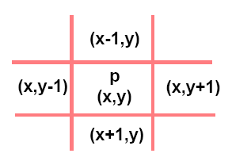
Basic Relationship between Pixels …
A pixel p at location (x,y) has two horizontal and two vertical neighbors.
This set of four pixels is called 4-neighbors of p=N₄(p).
Each of these neighbors is at a unit distance from p.
If p is a boundary pixel then it will have less number of neighbors.

Slide 40
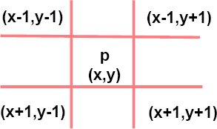
Basic Relationship between Pixels …
A pixel p has four diagonal neighbors=N_{D}(p)
The points of N₄(p) and N_{D}(p) together are called 8-neighbors of p.
N₈(p) = N₄(p) U N_{D}(p)
If p is a boundary pixel then both N_{D}(p) and and N₈(p) will have less number of pixels.

Slide 41
Basic Relationship between Pixels …
Two pixels are said to be connected if they are adjacent in some sense
🞑 They are neighbors(N₄,N_{D} or N₈) and
🞑 Their intensity values (gray levels) are similar
For a binary image B, two points p and q will be connected if q€N(p) or p€N(q) and B(p) = B(q).

Slide 42
Adjacency
Let V be the set of intensity values
4-adjacency: Two pixels p and q with values from V are 4-adjacent if q is in the set N₄(p).
8-adjacency: Two pixels p and q with values from V are 8-adjacent if q is in the set N₈(p).
m-adjacency: Two pixels p and q with values from V are m-adjacent if
q is in the set N₄(p), or
q is in the set N_{D}(p) and the set N₄(p) ∩ N₄(q) is empty
(has no pixels whose values are from V).

Slide 43

Examples: Adjacency and Path
Find 8-adjacency & m-adjacency of the pixel in the centre.
Note: V = {1}

Slide 44
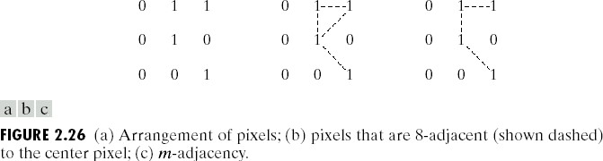
Examples: Adjacency and Path
V = {1}
Fig (b) shows the ambiguity in 8-adjacency

Slide 45
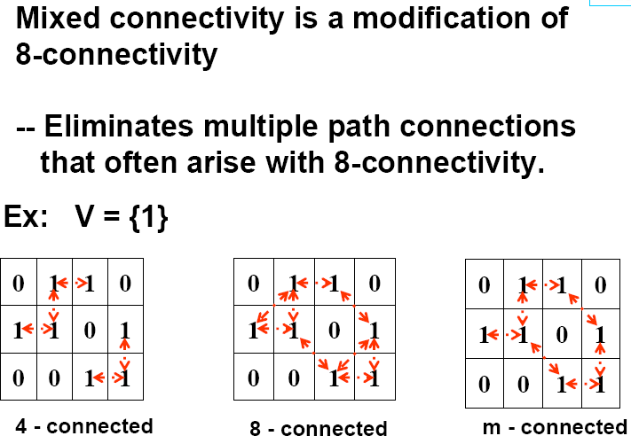
Examples: Adjacency and Path …

Slide 46
Path
A (digital) path (or curve) from pixel p with coordinates (x₀, y₀) to pixel q with coordinates (x_{n}, y_{n}) is a sequence of distinct pixels with coordinates
(x₀, y₀), (x₁, y₁), …, (x_{n}, y_{n})
Where (x_{i}, y_{i}) and (x_{i-1}, y_{i-1}) are adjacent for 1 ≤ i ≤ n.
Here n is the length of the path.
If (x₀, y₀) = (x_{n}, y_{n}), the path is closed path.
We can define 4-, 8-, and m-paths based on the type of adjacency used.

Slide 47
Connectivity
Connected in S
Let S represent a subset of pixels in an image.
Two pixels p with coordinates (x₀, y₀) and q with coordinates (x_{n}, y_{n}) are said to be connected in S if there exists a path
(x₀, y₀), (x₁, y₁), …, (x_{n}, y_{n}) Where

Slide 48
Distance Measures
Given pixels p, q and z with coordinates (x, y), (s, t), (u, v) respectively, the distance function D has following properties:
1. D(p, q) ≥ 0 [D(p, q) = 0, iff p = q]
Identity
2. D(p, q) = D(q, p)
Symmetry
3. D(p, z) ≤ D(p, q) + D(q, z)
Triangular inequality

Slide 49
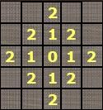
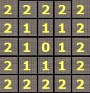
Distance Measures …
The following are the different Distance measures:
Euclidean Distance :
D_{e}(p, q) = [(x-s)² + (y-t)²]^{1/2}
City Block Distance
City Block Distance:
D₄(p, q) = |x-s| + |y-t|
Chess Board Distance:
D₈(p, q) = max(|x-s|, |y-t|)
Chess Board Distance

Slide 50
Assignment -1
When you enter a dark theater on a bright day, it takes an appreciable interval of time before you can see well enough to find an empty seat. Which of the visual process is at play in this situation?
Consider the two image subsets, S1 and S2, shown in the following figure. For V={1}, determine whether these two subsets are a) 4-adjacent, b) 8-adjacent, or c) m-adjacent.
 |  | S1 |  |  |  |  | S2
0 | 0 | 0 | 0 | 0 | 0 | 0 | 1 | 1 | 0
1 | 0 | 0 | 1 | 0 | 0 | 1 | 0 | 0 | 1
1 | 0 | 0 | 1 | 0 | 1 | 1 | 0 | 0 | 0
0 | 0 | 1 | 1 | 1 | 0 | 0 | 0 | 0 | 0
0 | 0 | 1 | 1 | 1 | 0 | 0 | 1 | 1 | 1

Slide 51
Assignment -1 …
Consider the image segment shown
Let V={0,1} and compute the length of the shortest 4-,8-, and m-path between p and q. if a particular path does not exist between these two points, explain why.
Repeat for V={1,2}
 | 3 | 1 | 2 | 1 | (q)
 | 2 | 2 | 0 | 2
 | 1 | 2 | 1 | 1
(p) | 1 | 0 | 1 | 2

Slide 52

Any Questions ?

